Slide 1
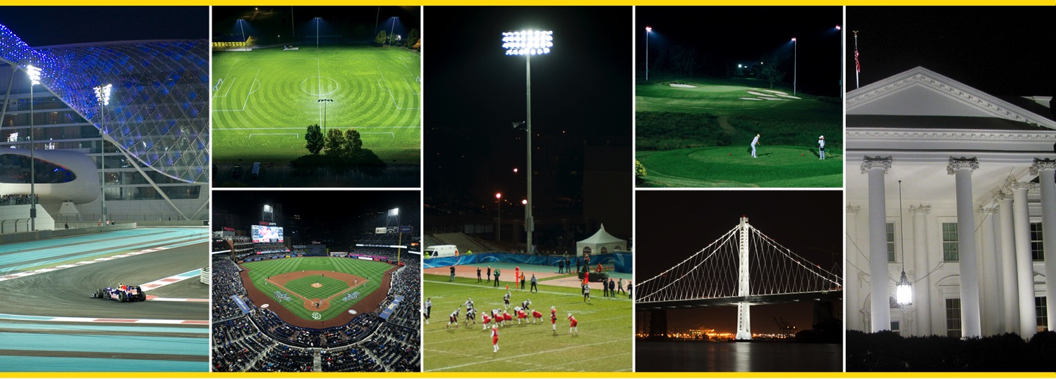

Solutions for Sports Lighting - Caiola Baseball
© 2016 Musco Sports Lighting LLC
Notes:
Welcome - introductions

Slide 2
Evolution of Glare Control Technology
Fixture Design
2
Notes:
Musco has been on a 40 year journey of research, product development and solving market driven challenges. The goal has been to figure out how to maintain the balance between field performance (playability), energy efficiency and light control.

Slide 3
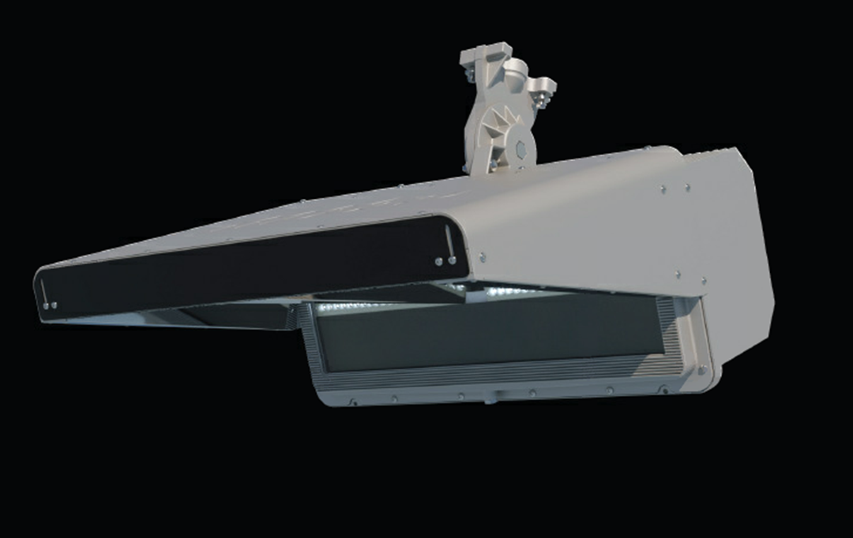
Musco TLC-LED Luminaire
Notes:
Set up Demo
Typical set up for a soccer field simulating 70 foot mounting heights and a 30 degree aiming angle
The fixture is a 1/3 scale model of our real TLC – LED fixture being proposed for this project
Every LED fixture manufacturer starts out with these three basic components:
Heat Sink
LED Board
TIR optic – Total Internal Reflectance
This is where the they stop but we don’t.
Demo: get volunteer to sit at the end of table to simulate the view of the light fixture 100 and 150 feet from the table.
1st. Visorless – use side beam board to illustrate beam pattern
2nd Fixed visor – do you see the difference?
What visor length would you need to impact cutoff?
Musco Optic – what do you observe – that’s because we block the light source from the offsite view while enhancing the on-field lighting levels. If you can see the light source, you experience glare – repeat often!
Observe the ball. It can be tracked very effectively but what happens when it goes up.
Introduce Ball Tracking and turn on the uplight fixture and be sure to turn off overhead lighting.
Observe the light from the wall and ball shaping board. If you have the 400 watt fixture, observe the light modeled against the wall. The real TLC-400 watt fixture effectively duplicates the 1/3 model demo.

Slide 4
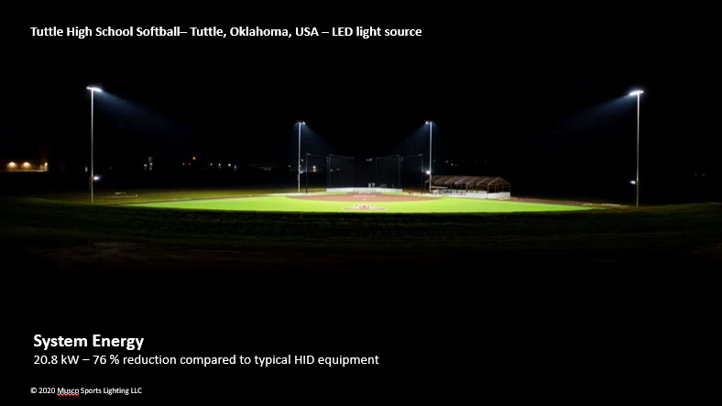
Notes:
Set up Demo
Typical set up for a soccer field simulating 70 foot mounting heights and a 30 degree aiming angle
The fixture is a 1/3 scale model of our real TLC – LED fixture being proposed for this project
Every LED fixture manufacturer starts out with these three basic components:
Heat Sink
LED Board
TIR optic – Total Internal Reflectance
This is where the they stop but we don’t.
Demo: get volunteer to sit at the end of table to simulate the view of the light fixture 100 and 150 feet from the table.
1st. Visorless – use side beam board to illustrate beam pattern
2nd Fixed visor – do you see the difference?
What visor length would you need to impact cutoff?
Musco Optic – what do you observe – that’s because we block the light source from the offsite view while enhancing the on-field lighting levels. If you can see the light source, you experience glare – repeat often!
Observe the ball. It can be tracked very effectively but what happens when it goes up.
Introduce Ball Tracking and turn on the uplight fixture and be sure to turn off overhead lighting.
Observe the light from the wall and ball shaping board. If you have the 400 watt fixture, observe the light modeled against the wall. The real TLC-400 watt fixture effectively duplicates the 1/3 model demo.

Slide 5
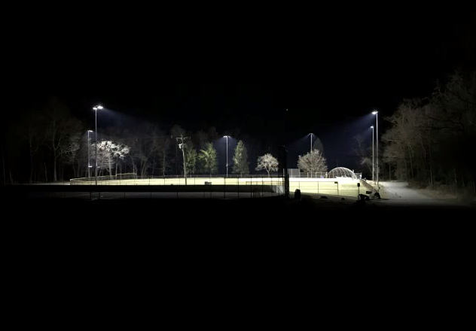
Masar Park Boonton, NJ
400’ Field Edge to Camera
Notes:
Set up Demo
Typical set up for a soccer field simulating 70 foot mounting heights and a 30 degree aiming angle
The fixture is a 1/3 scale model of our real TLC – LED fixture being proposed for this project
Every LED fixture manufacturer starts out with these three basic components:
Heat Sink
LED Board
TIR optic – Total Internal Reflectance
This is where the they stop but we don’t.
Demo: get volunteer to sit at the end of table to simulate the view of the light fixture 100 and 150 feet from the table.
1st. Visorless – use side beam board to illustrate beam pattern
2nd Fixed visor – do you see the difference?
What visor length would you need to impact cutoff?
Musco Optic – what do you observe – that’s because we block the light source from the offsite view while enhancing the on-field lighting levels. If you can see the light source, you experience glare – repeat often!
Observe the ball. It can be tracked very effectively but what happens when it goes up.
Introduce Ball Tracking and turn on the uplight fixture and be sure to turn off overhead lighting.
Observe the light from the wall and ball shaping board. If you have the 400 watt fixture, observe the light modeled against the wall. The real TLC-400 watt fixture effectively duplicates the 1/3 model demo.

Slide 6
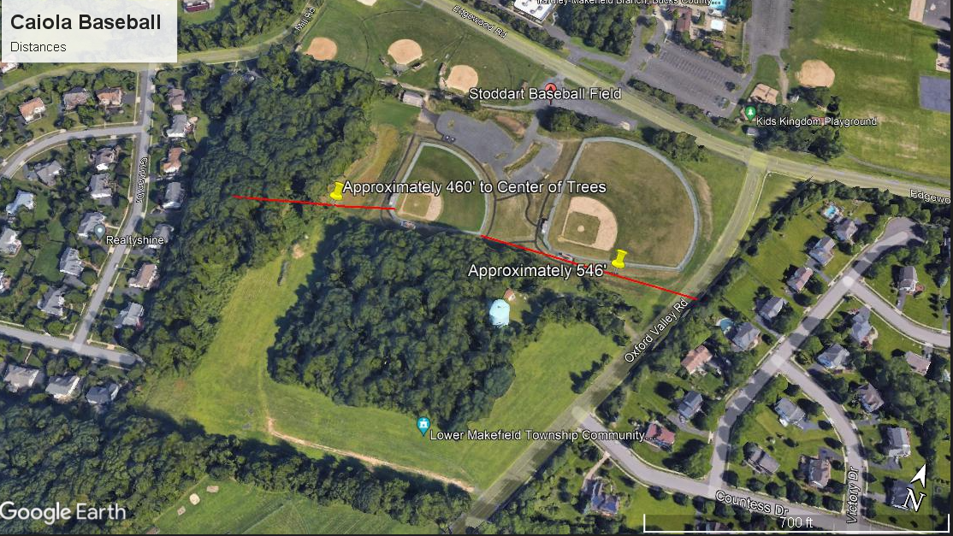
© 2016 Musco Sports Lighting LLC
Notes:
Thank you

Slide 7
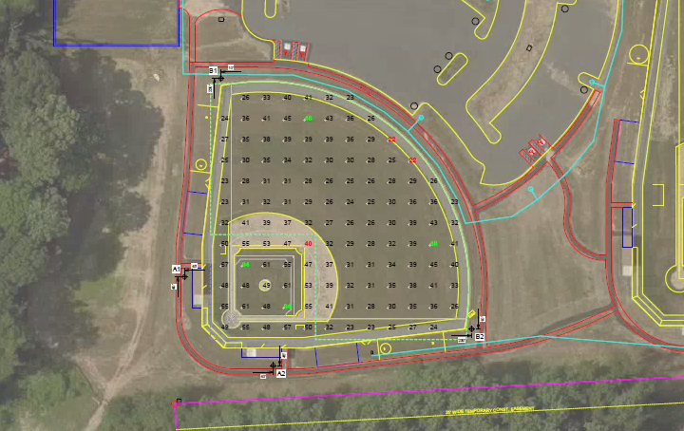

Slide 8
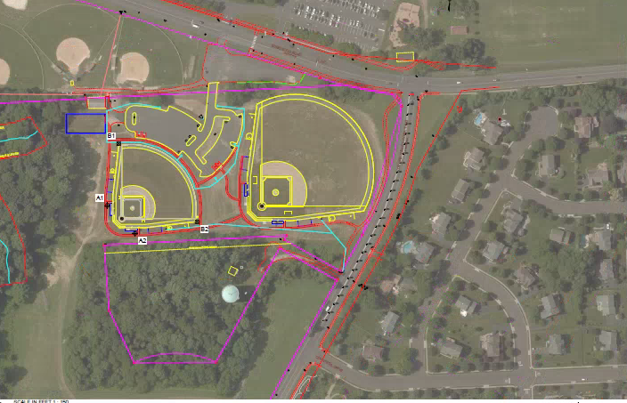

Slide 9
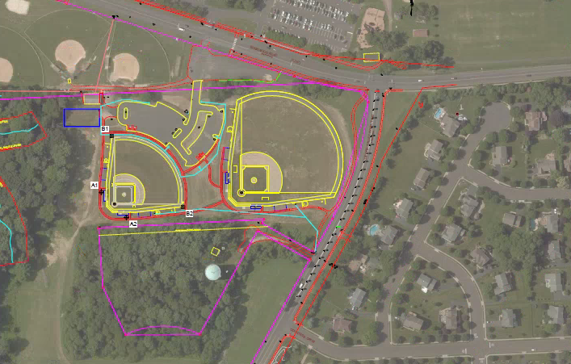

Slide 10
