Slide 1
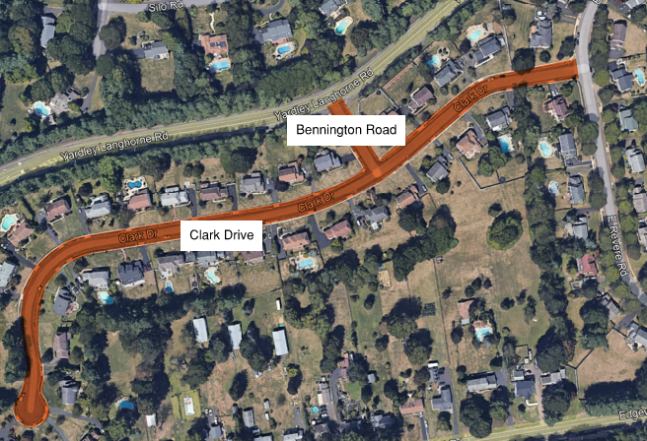
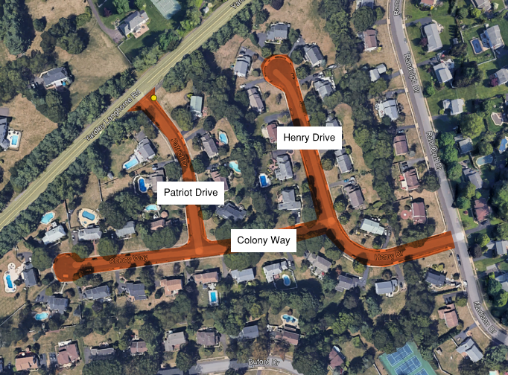
LOWER MAKEFIELD TOWNSHIP 2024 ROAD PROGRAM
Base Bid – Mill & Overlay Roads + Update Ramps to ADA Standard – Yardley Hunt Neighborhood
Clark Drive, Bennington Road, Patriot Drive, Colony Way, Henry Drive

Slide 2
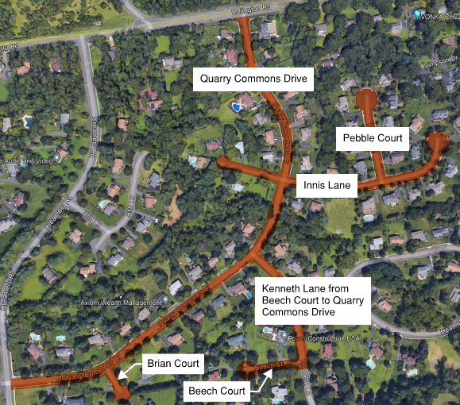
LOWER MAKEFIELD TOWNSHIP 2024 ROAD PROGRAM
Base Bid – Mill & Overlay Roads + Update Ramps to ADA Standard – Quarry Commons Neighborhood
Quarry Commons Drive, Innis Lane, Pebble Court,
Kenneth Lane from Beech Court to Quarry Commons Drive,
Brian Court, Beech Court

Slide 3
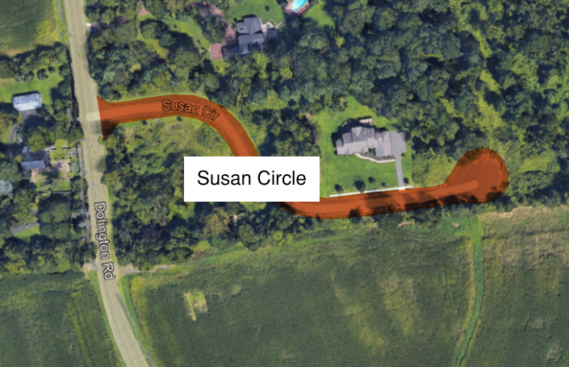
LOWER MAKEFIELD TOWNSHIP 2024 ROAD PROGRAM
Alternate Bid #1 – Final Paving of Roadway
Susan Circle

Slide 4
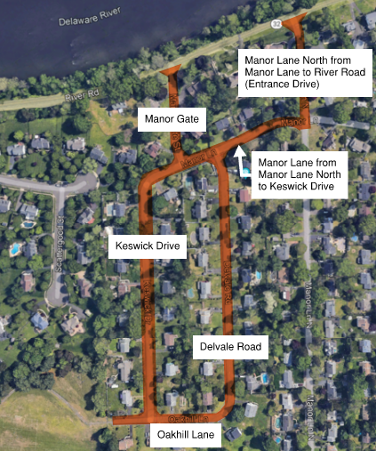
LOWER MAKEFIELD TOWNSHIP 2024 ROAD PROGRAM
Alternate Bid #2 – Mill & Overlay Roads – Penn Valley Terrace Neighborhood
Manor Lane North from Manor Lane to River Road (Entrance Drive), Manor Gate,
Manor Lane from Manor Lane North to Keswick Drive, Keswick Drive, Oakhill Lane, Delvale Road

Slide 5
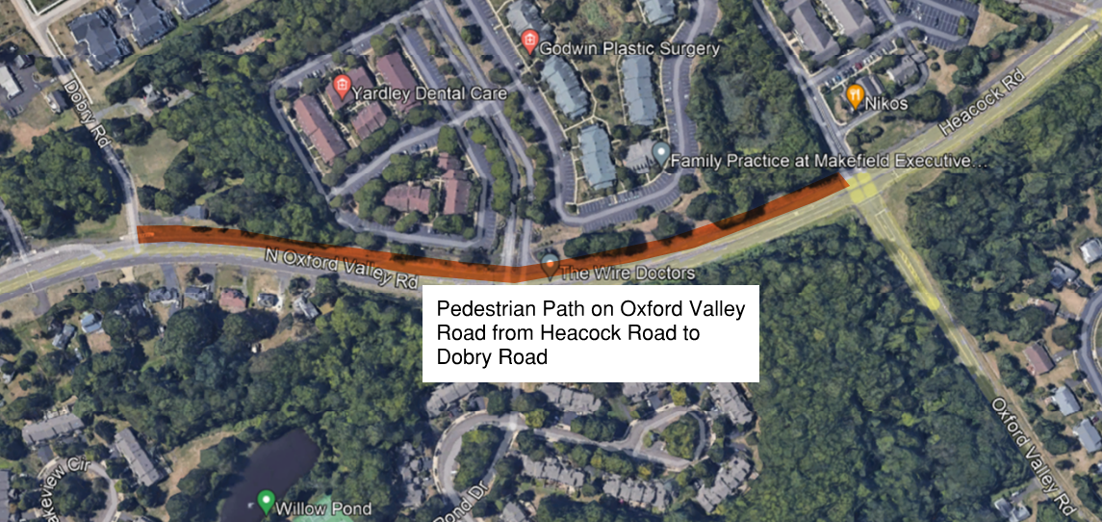
LOWER MAKEFIELD TOWNSHIP 2024 ROAD PROGRAM
Alternate Bid #3 – Mill & Overlay Trail
Pedestrian Path on Oxford Valley Road from Heacock Road to Dobry Road

