Slide 1
Toptracer Range
Makefield Highlands G.C.
6.5.24

Slide 2
Statistics & Growth YTD
How can Toptracer help you reach your goals

Slide 3
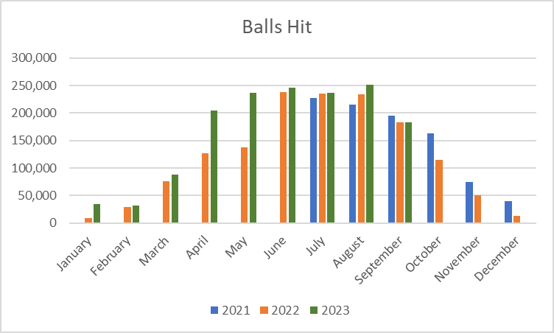
Balls Traced Since Installation – 03/01/2022
Comparable YOY 2021, 2022,2023
2021 Balls Traced Monthly Average:
152,614
2022 Balls Traced Monthly Average:
168,191
2023 Balls Traced Monthly Average:
206,737
YOY: +26% Growth from 2021
Notes:
Investigating license costs and development cost/timeline for Angry Birds and Jewel Jam.

Slide 4
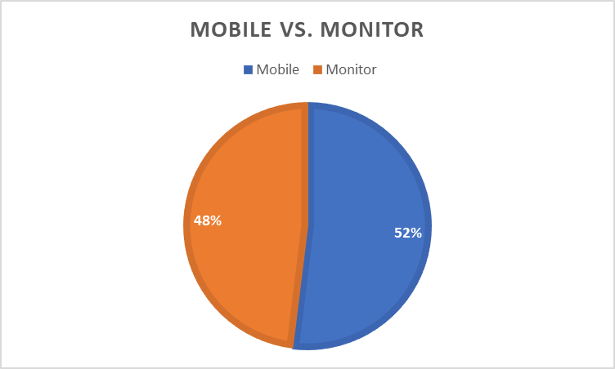
Mobile vs. Monitor YTD
With Cover the Tees = Increase In Monitor
Notes:
Investigating license costs and development cost/timeline for Angry Birds and Jewel Jam.

Slide 5
Corporate Monitor rentals
52% of balls hit were from Monitors
Outing Monitor rentals for non golfers
Increase number of players who are not playing on the course
Those that only participate in the Luncheon or Awards can now use Toptracer for 2 hours
Enhance growing the game of golf
Adds an Off Season Opportunity
Balls hit from November – February decrease significantly
Cover the Tees building will enhance off season play
Lots of room to grow during those 4 months
Off season leagues
Continue your golf league throughout the winter
Safe place for private parties
Create an atmosphere for customers to relax and enjoy the hitting bays
Areas for Future Growth
Notes:
Investigating license costs and development cost/timeline for Angry Birds and Jewel Jam.

Slide 6
Growth Pre and Post Toptracer
Pre Toptracer 2018 – 2020
Total Range Revenue = $468,991
Average Annual Range Revenue = $156, 330
Post Toptracer 2021 – 2023 (install July ‘21)
Total Range Revenue = $636,221
Average Annual Range Revenue = $212,073
Average Annual Revenue Increase = $55,743
Bay Rental Revenue Since Install = $38,220
Average Annual Bay Rental Revenue = $12,740
Notes:
Investigating license costs and development cost/timeline for Angry Birds and Jewel Jam.

Slide 7
Pricing
Toptracer Bucket Pricing with Toptracer Included (Market Standard Pricing)
$0.18 - $0.20 per ball
Makefield current = $0.17
MHGC Current Pricing
Medium = $9 - 50 Balls $0.18
Large = $13 - 75 Balls $0.17
MHGC 2025 Increases
Medium = $11- 50 Balls $0.22 per ball
Large = $15 – 75 Balls $0.20 per ball
Price Increase = $37,000 plus additional Bay Rentals
Notes:
Investigating license costs and development cost/timeline for Angry Birds and Jewel Jam.

Slide 8
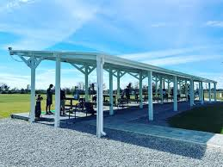
Cover the Tees
Cover the Tees Investment = $100,000
3 Year Pay Back Plan and ROI
Price Increase Revenue $37,000
Bay Rental Revenue $18,000
Event Revenue $15,000
Total ROI Yearly $70,000
Notes:
Investigating license costs and development cost/timeline for Angry Birds and Jewel Jam.

