Slide 1
Improving our Trash and Recycling Collection System
March 19, 2025

Slide 2
Overview
In 2024, the Board of Supervisors tasked the Environmental Advisory Council (EAC) with reviewing the environmental and economic impact of our current trash and recycling collection system.
Supervisors had expressed concern about the impact on our roads and air quality from having upwards of 8 trash trucks drive our roads each week.
Additionally, Supervisors had received concerns about service quality, from missed pickups to debris left on the street.
Finally, some were concerned that haulers were engaging in anti-competitive pricing actions designed to lock customers into longer-term relationships with escalating prices.

Slide 3
Current Practice – Individual Subscription
LMT Trash/Recycling Haulers
  Waste Management: $516 - $963 per year
  McCullough: $408 - $564 per year
  Casella (Whitetail): $440 – $560 per year
Approximately 9,000 households with an individual subscription for collection
Approximately 2,000 residences in neighborhood /condo/apartment complexes with their own contract

Slide 4
Other Collection Options Examined
Township Owned and Operated Collection
Township Contracted Collection
Zoned Contracted Collection
Individual Subscription with Township Negotiated Price

Slide 5
Township Owned and Operated Collection
Common in large municipalities (ex. Philadelphia, Harrisburg, Trenton) and potentially offers the lowest total cost of ownership
Significant initial capital costs for trucks (~$300,000 each)
On-going Costs:
  Additional workers to operate trucks
  Township workers to manage program
  Truck maintenance
  Disposal fees

Slide 6
Township Contracted Collection
The Township contracts with one private waste hauler.
A competitive bid process selects a hauler, and contracts generally run 3 to 5 years, allowing for pricing stability for residents.
Due to labor/fuel/collection efficiencies, common in higher density areas
If the Township provides billing services (inclusion in tax bill), it could have more control over service outcomes.

Slide 7
Neighboring Municipalities with Contracted Collection
Municipality | Hauler | Annual Cost | Pickups per Week
 |  |  | Trash | Recycling | Leaf/Yard Waste | Bulk
Northampton Township | Casella/ Whitetail | $575 | 1 | 1 | 1 | 1
Middletown Township | Waste Management | $401 (current) | 2 | 1 | 1 | 1
 |  | $476 (2025-29) | 1 | 1 | 1 | 1 (month)
Morrisville | Republic | $425 | 2 | 1 | Fall | 1
Yardley | Republic | $420 | 2 | 1 | Fall | 1
Bristol Township | Waste Management | $418 | 1 | 1 | 1 | 1 (month)

Slide 8
Zoned Township Contracted Collection
Township split into 2 or 3 zones
Each zone would have a contract allowing different companies to compete
Complexities - different pricing/different services in each zone, billing?

Slide 9
Township Negotiated Price with Each Hauler
The Township could also require that all haulers give price guarantees for a specific period and mandate a service level. The Township recently did something similar when it created a list of approved sewer line inspectors.
Lacks most environmental and Township financial advantages of contracted hauling
No examples of use by municipalities

Slide 10
EAC Recommendation:
RFP for Township Contracted Collection
Once a week pickup of trash, recycling, and yard/leaf waste with service level and price guarantees
Automated collection of trash and recyclables
Billing by annual property tax
Monthly curbside collection of bulk waste
Include Township parks and buildings

Slide 11
Advantages to the Environment
Reduced traffic congestion, noise and greater safety on roads
Reduced fuel use and air emissions (diesel particulates, nitrogen oxides, and greenhouse gases)
Greater composting of residential yard /leaf waste with curbside pick-up.

Slide 12
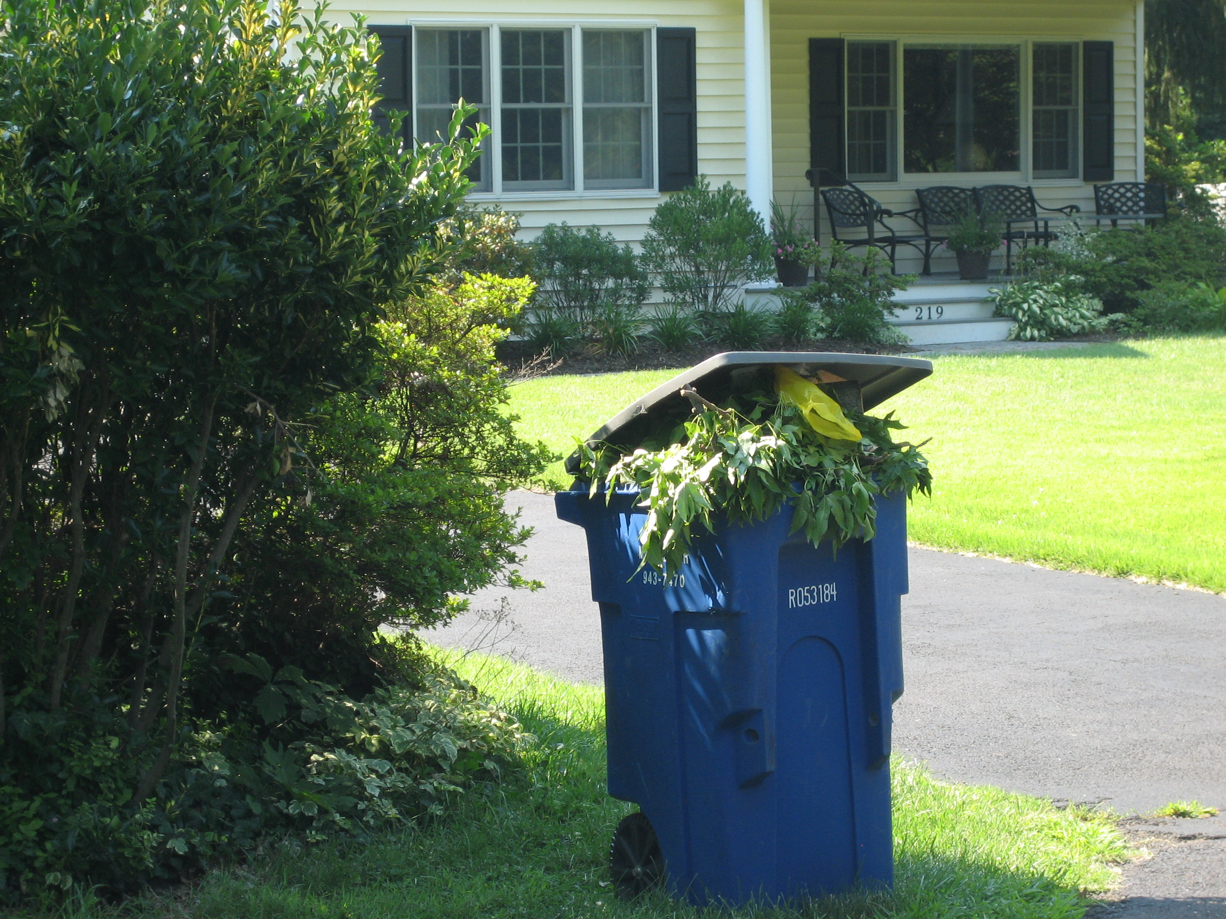

Slide 13
Advantages to the Residents
Stabilization and possible reduction in costs.
Ability to manage and assess hauler performance and advocate for additional services
Greater convenience with curbside yard/leaf and bulk item collections.
Possible reduction of $94 annual leaf collection fee

Slide 14
Township Financial Benefits
LMT parks and buildings waste collection in contract: save $39,300 per year.
Eliminates need for yard waste recycling facility: saves $80,000 a year
Reduced need/cost of the Township’s $830,000 per year fall leaf collection
Reduced damage and wear and tear of local streets from reduced trash truck traffic (LMT $2.17 million repaving costs in 2025)

Slide 15
Next Steps
Generate bid document – Recent examples from Middletown and Bristol Townships provided
Determine if changes to the Solid Waste Ordinance (Chapter 172) are needed
BOS evaluates bids and decides whether to accept

