Slide 1

2026 Budget
Decision Points

Slide 2
General Fund- Operating
  Operating Revenue Consideration
    Transfer $2.4M from Sewer Fund (Will hold us through 2026)
    Increase general purpose millage rate up to statutory cap of 14 mills (approximately $66,360 of additional revenue at face; taxpayer impact equals $5.23 assuming average residential assessment of $43,600)
    Petition the Court of Common Pleas to exceed the statutory cap of 14 mills up to the 19 mills for general purposes consistent with Section 3205 (1) of the Second-Class Township Code
    Levy a stormwater utility fee, which would result in an interfund transfer of $283,000 for existing GF personnel expenses

Slide 3
General Fund- Capital
  New Capital Requests
    DPW - Zero Turn Mower - $12,500; replacement of 2020 Zero Turn Mower
    Police - Vehicles
      Purchase Requests
        3—Upfitted Ford Explorers (patrol) financed - $92,604 (annual cost for 3 years); part of strategy to transition patrol vehicles from lease to purchase
      Lease Requests
        4 CID Vehicles (mid-size sedan/compact SUV)—Lease -$36,000 (annual cost for 5 years); replace 2013 Dodge Journey with 56,000 miles, 2015 Toyota Camry with 38,000 miles, 2016 Dodge Charger with 73,000 miles, and 2017 Chevy Tahoe with 76,000 miles
        4 CID Vehicles Upfitting - $32,000 (one-time cost)

Slide 4

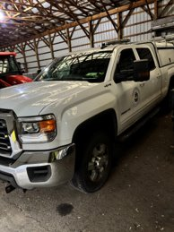
Park and Recreation Fund
Capital Project Request
  5 Mile Woods Trail- $10,000 - PECO Green Region Grant
New Capital Purchase Requests
  Zero Turn Mowers - $13,000; replacement of 2018 Zero Turn Mower
  Pick-up Truck - $22,500 (annual cost for 5 years); replacement of 2015 GMC 3500HD with 120,000 miles

Slide 5
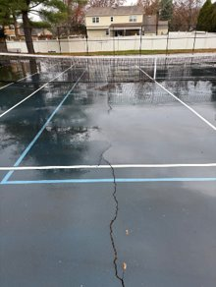
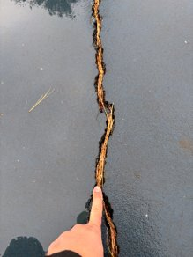

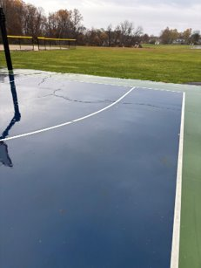
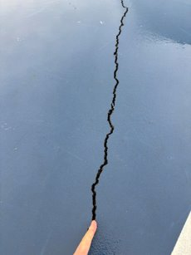

Park Fee In Lieu of Fund
New Capital Project Requests
  Kids Kingdom - $150,000 for design
  Revere Pickleball Court Replacement - $250,000 for complete surface removal and reconstruction with proper subbase preparation
  Community Park Basketball and Tennis Court Surface Maintenance - $25,000 for crack repair
  Pool Heaters - $68,000 ($7,150 for Baby Pool, $58,635 for Olympic Pool, and electrical installation allowance)
Revere Court
Community Park Basketball Court

Slide 6
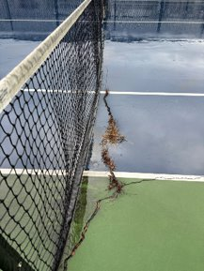
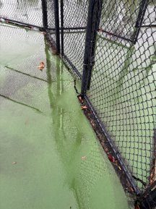
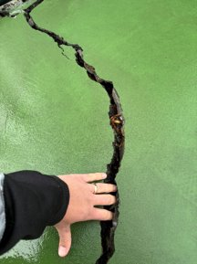
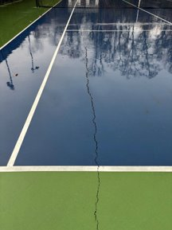
Park Fee In Lieu of Fund – Repair Considerations
Community Park Tennis Court

Slide 7
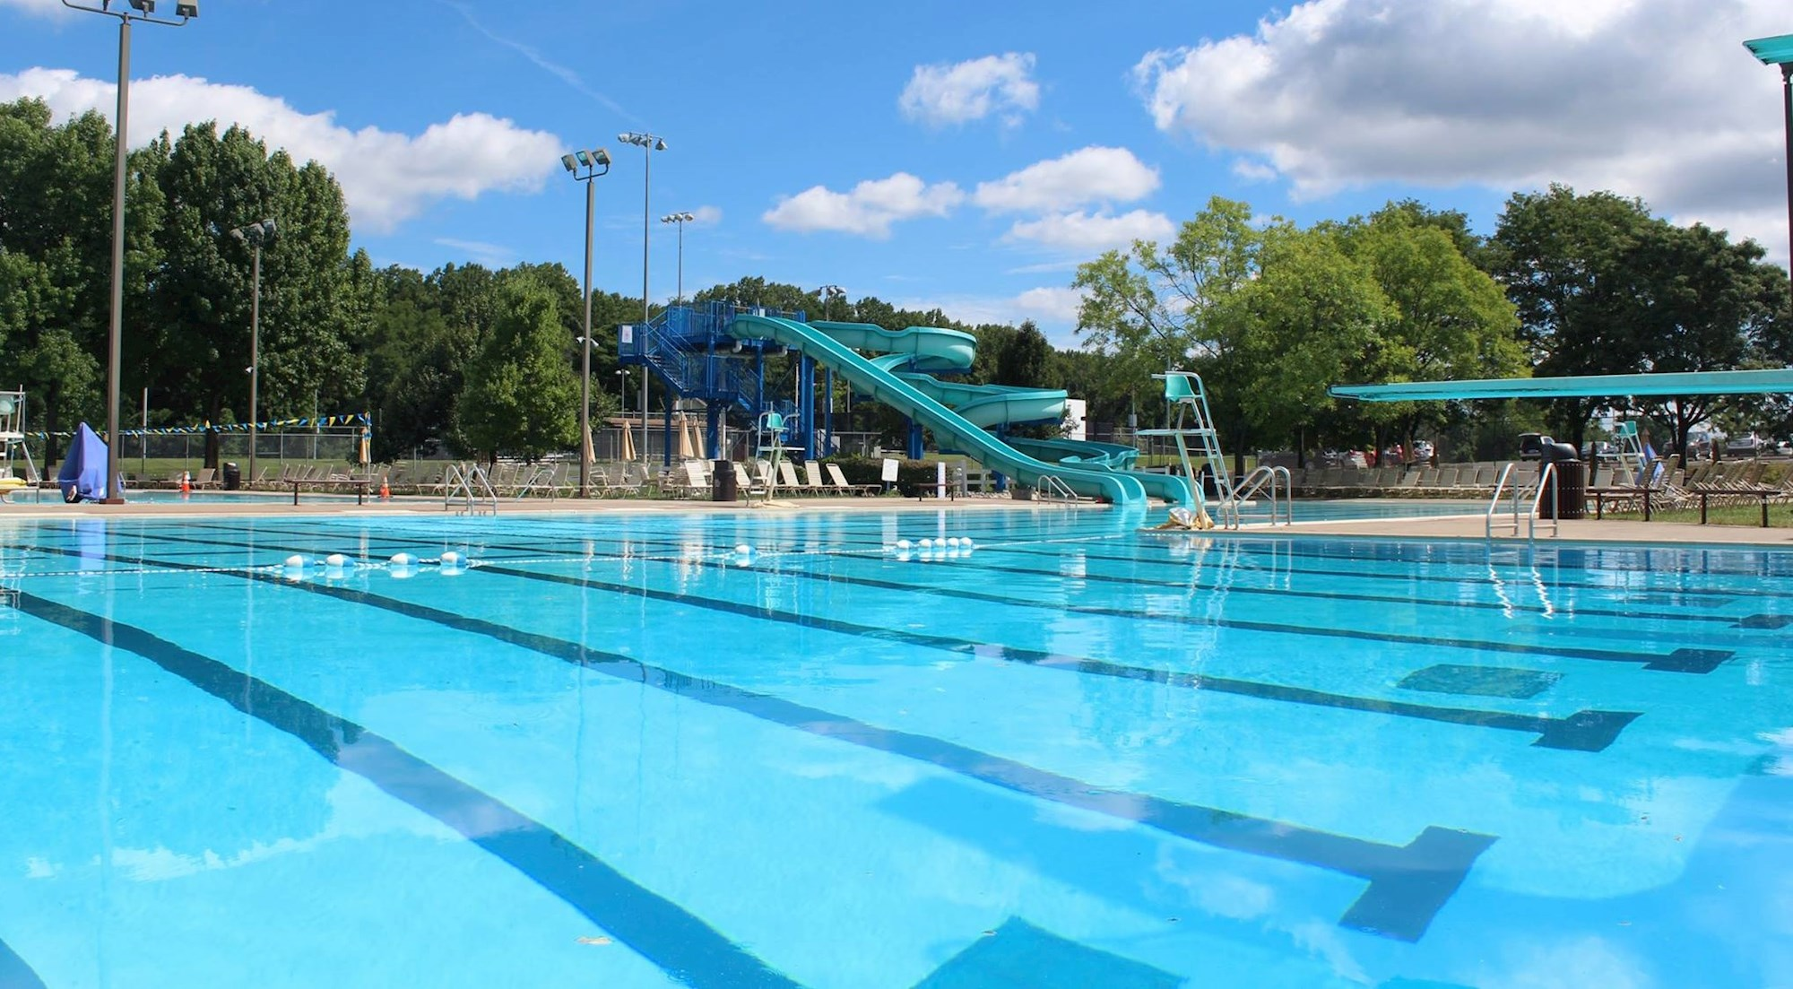
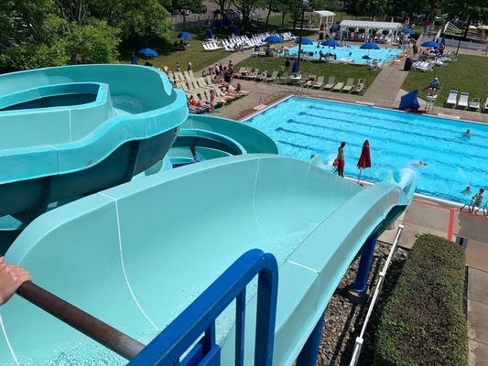
Pool Fund
  Operating Revenue and Expense Considerations
      Change in membership fee and sales strategy
        Establish a $600 per family resident cap, no non-resident cap, maintain 2025 pricing, discount period (10%) from December 1, 2025 through February 17, 2026
      Adjust fee charged to LMT Swim and Dive to charge in a manner consistent with league pricing ($30 per resident and $60 per non- resident)
      Change operating hours
        May 23rd – June 15th - Saturday and Sunday only 9am-7pm; Memorial Day 10am-6pm; May 30th 9am-2pm
        June 16th – August 16th – Monday through Thursday 12pm – 8pm; Friday 12pm – 9pm; Saturday 10am – 9pm; Sunday 10am -8pm; July 4th 10am – 6pm
        August 17th – August 28th - Monday through Thursday 3:30pm – 8pm; Friday 3:30pm – 9pm; Saturday 10am – 9pm; Sunday 10am -7pm
        August 29th – September 7th - Saturday and Sunday only 9am-7pm; Labor Day 10am-6pm
      Park and Recreation special purpose millage rate increase to offset 2025 fund balance deficit in Pool Fund ($203,020) and 2026 budgeted operating deficit ($86,259); approximately 0.53 mill increase; taxpayer impact equals $23.11 assuming average residential assessment of $43,600)

Slide 8
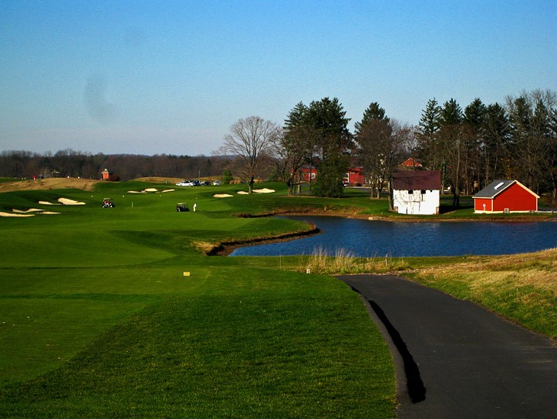
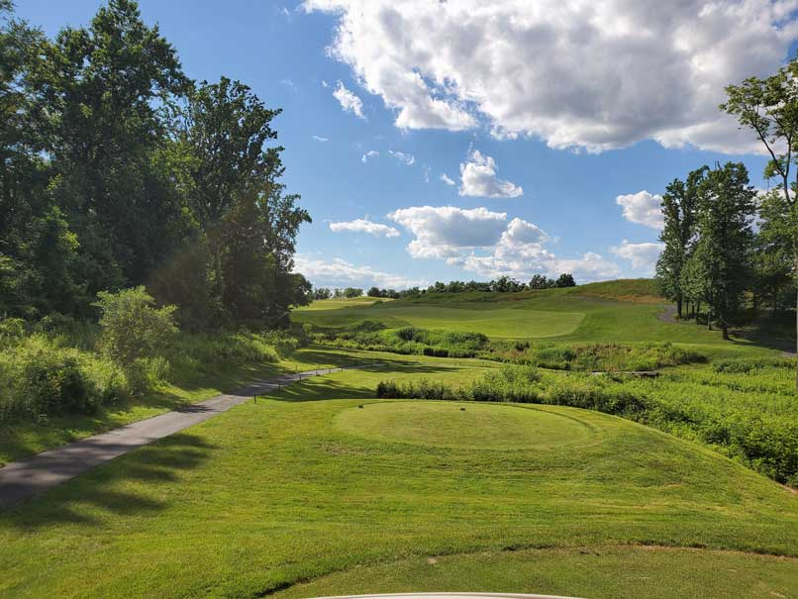

Golf Fund
Operating
  Interfund Out Transfers
    General Fund ($455,000 in 2025)
    Golf Bond Repayment ($75,000 in 2025)
    Golf Capital ($225,000 in 2025)
    $555,498 in excess operating revenues available for transfer in 2026 with full funding for contemplated capital projects (projected 2025 year-end fund balance of $1,648,624)
Capital Project Requests
  9th Hole Irrigation Pond – Dredged and Lined - $800,000
  New Well on Hole 15 - $100,000
  Water Service for Pond - $150,000
Funding for Capital Requests
  Golf Capital Fund – $500,000 (interfund transfer)
  Golf Course Fund - $550,000 (paid out of 2026 operating revenues)

Slide 9
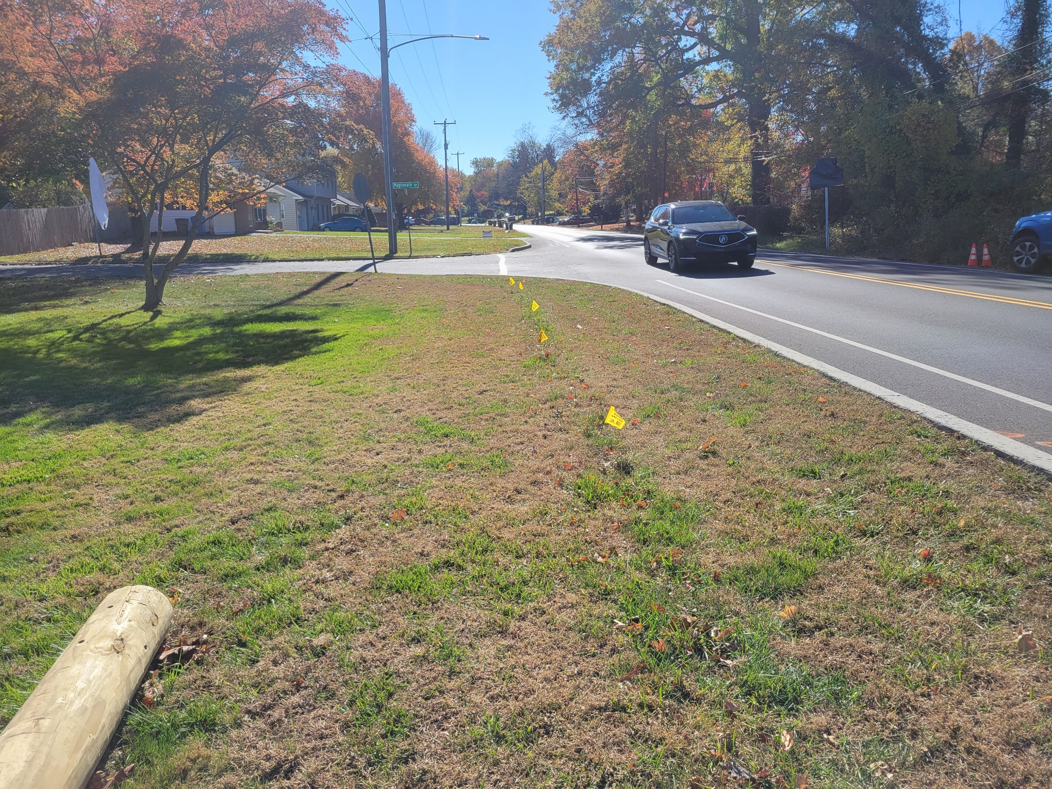
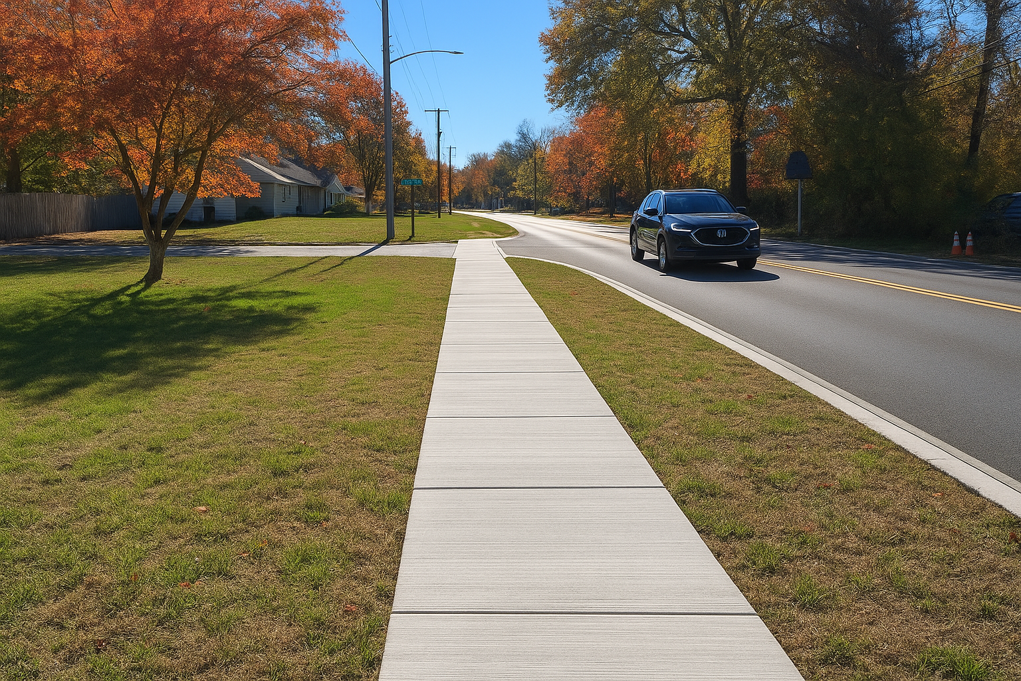
Special Projects Fund
Capital Requests
  Handgun Replacement and Ammunition - $56,581(funded using LMT Community Foundation funds- private restricted donations)
  Taylorsville Road Curb and Sidewalk - $2,503,526 (dependent on external grant funding)
  Stormwater PRP Design - $500,000 funded using 2016 General Obligation Bond Proceeds
  Traffic Signal Improvements - $150,000 funded using 2016 General Obligation Bond Proceeds; place holder for potential grant match for Green Light Go Program (requires a minimum of 20% match)

Slide 10
Special Projects Fund
2016 General Obligation Bond Proceeds
Lower Makefield Township
General Obligation Bonds, Series of 2016
 |  | Notes
Balance as of 12/31/24 | $4,700,950.24
Balance as of 01/31/25 | $4,719,018.26 | Interest earned of $18,068.02
Balance as of 02/28/25 | $4,735,298.51 | Interest earned of $16,280.25
Budgeted Transfer to Special Projects | $1,500,000.00
Budgeted Transfer to Patterson Farm | $700,000.00 | $177,945 spent to date (painting), $21,535 anticipated to be spent (asbestos); $500,520 anticipated to be available to be rolled over into 2026
Transfer | $534,926.57 | Transfer to correct improper transfer to PLGIT as part of isolating bond proceeds, which were previously commingled with non-bond proceed funds
Balance as of 03/31/25 | $2,015,010.32 | Interest earned of $14,638.38
Balance as of 04/30/25 | $2,022,317.11 | Interest earned of $7,306.79
Balance as of 05/31/25 | $2,029,835.44 | Interest earned of $7,518.33
Balance as of 06/30/25 | $2,037,121.49 | Interest earned of $7,286.05
Balance as of 07/31/25 | $2,044,692.10 | Interest earned of $7,286.05
Balance as of 08/31/25 | $2,052,264.63 | Interest earned of $7,572.53
Balance as of 09/30/25 | $2,059,551.21 | Interest earned of $7,286.58
Balance as of 10/31/25 | $2,066,949.66
Additional Needed Transfer to Special Projects for Ongoing Projects | $265,000.00
Anticipated Year End Balance (12/31/25) | $1,813,949.66 | Assumes addditional interest earnings of $12,000 from November to December 2025
Big Oak Road and Makefield Road Intersection Improvement Project (construction) | $400,000.00
Woodside Road Multiuse Trail, Phase 2 (additional work) | $180,000.00
Woodside Road and Taylorsville Road Trail Crossing | $250,000.00
Pollution Reduction Design Costs | $500,000.00
Green Light Go Funding Program Application | $150,000.00
Unallocated Balance | $333,949.66

Slide 11

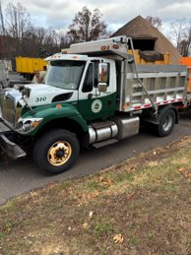
Liquid Fuels Fund
  Anticipated 2025 Year-End Fund Balance available for equipment purchase is $337,484.15
  2026 Allocation is $980,000 (20% eligible of allocation available for equipment purchase equals $196,000.00
  Total Available for Equipment Purchase in 2026 equals $533,484.15
  Committed Capital Purchase Requests
    $54,458 for Upfit of Small Dump Truck (approved in 2025)
    $136,877 for Upfit of Large Dump Truck (approved in 2025)
  New Capital Purchase Request
      Large Dump Truck - $320,000

Slide 12

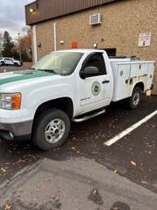
Road Machinery Fund
No increase proposed in special purpose millage rate
Capital Requests
  Woodchipper - $78,000
  Crew Cab with Utility and Plow 5 Year Financed - $14,700
  Crew Cab with Plow 5 Year Financed - $12,900

Slide 13

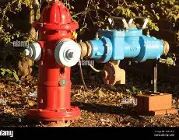
Hydrant Fund
Operating Revenue Consideration
  Proposed budget includes an increase in the special purpose millage rate
    0.33 mill to 0.373 mill
      Taxpayer impact equals $1.87 assuming average residential assessment of $43,600
    Necessary to fund increased hydrant service costs

Slide 14
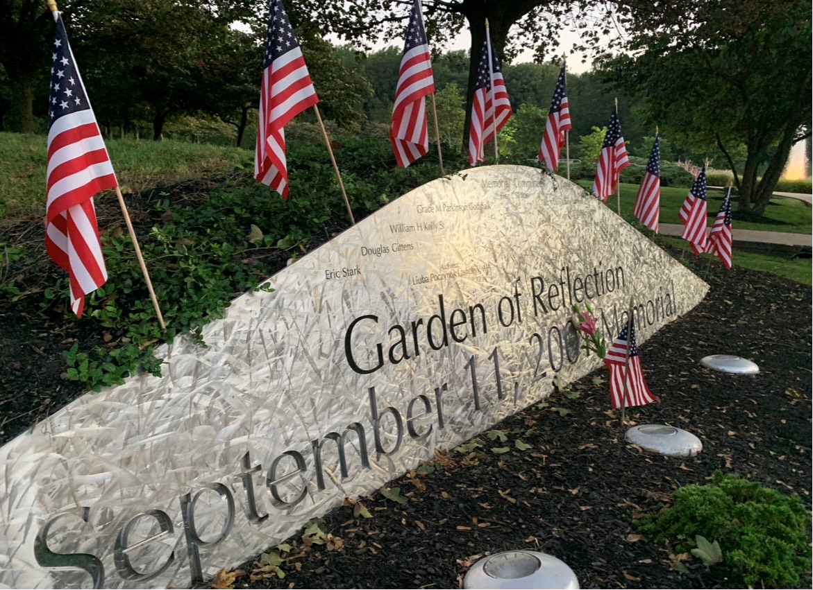
Garden of Reflection Capital Fund
  Capital Request
    Memorial Improvements - $1,000,000 funded by LSA Grant

Slide 15

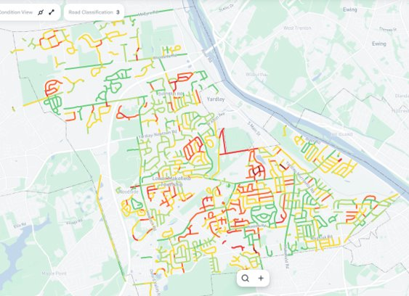
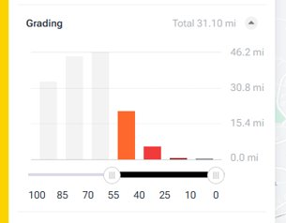
Roadway Improvement Fund
No proposed increase in special purpose millage rate
Capital Request
  Road Improvement - $2,000,000 (anticipates approximately 6 miles of roadway)

Slide 16
QUESTIONS?

